Slide 1

Regional Technical Forum
Year to Date Stats
November 22, 2013
RTF PAC Presentation

Slide 2
YTD Financials
96% of funding is allocated; 98% expected to be spent

Slide 3
2014 Funding

Slide 4
RTF Work Plan & Funding
2012 – 2014 long-term funding agreements
  3-yr Letter of Agreements w/ funders
  Allocations based on NEEA funding shares
Council collects funds on an annual basis
Inevitably there will be work that was committed and contracted for in the current year that extends into the following calendar year
2012 WP
2014 WP
1/1/2013
2013 WP
1/1/2014

Slide 5
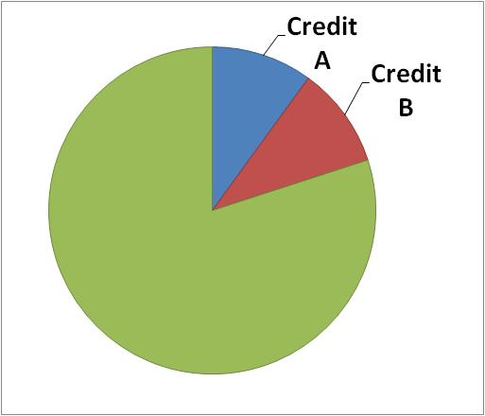
Council’s Carryover Strategy
In November 2011, the Council developed a new reconciliation and carryover strategy for RTF funding
  Credit A: Allow for funds from the previous year that were not obligated in contracts to be credited to funders towards the next year’s contribution
  Credit B: Allow for funds that
  were obligated but not spent to be
  reallocated towards the following
  year’s contributions
  Collect remaining funds

Slide 6
2014 – Anticipated Funding
Budget: $ 1,473,000
Credit A: $ 0 (2013 unobligated by 12/31/13)
Credit B: $ 59,679.44 (2012 unspent by 3/31/13)
We will be collecting $ 1,413,320.56 from funders for 2014 work plan
Expect a 2013 Credit B for your 2015 funding

Slide 7
2014 – What’s coming…
Expect 2014 funding packets in the next few weeks
  Invoice for 2014 obligation w/ memo
  Copies of 2014 work plan, budget
  Copy of signed letter of agreement
In April 2014, staff will send out a memo detailing 2013 close-out → notify you of unspent funds to be credited to 2015

Slide 8
Measure Status Check
Success should not be based on how many OOC measures get reinstated

Slide 9
Status check on Research Needs
Core objectives for RTF is to help coordinate research needs for measures & protocols
No research plans to bring OOC measures have been received
  Several measures deactivated; several moved to small saver category (negating research needs)
Not necessarily a bad thing, except…

Slide 10
Status check on Research Needs
Only 2 measures requiring research plans have been designed and implemented
  HPWH and DHP
  Both NEEA driven initiatives, not utility specific
One potentially large measure (DHW HX) recently deactivated due to no interest
  Projected 70 aMW region-wide
One Provisional Standard Protocol (Grocersmart) had plan approved, but not implemented
One Provisional UES (Strip Curtains) had plan approved, never researched, and now potential is almost exhausted
  Measure is relying on un-evaluated savings

